Slide 1
Gender Inequality in the Workspace: A Data-driven Analysis
Exploring Gender Disparities and Opportunities for Change

Slide 2
INTRODUCTION
Gender inequality manifests in different forms, such as the gender pay gap, underrepresentation of women in leadership positions, lack of access to education and healthcare for women and girls, and gender-based violence and discrimination. These disparities not only limit individual potential but also hinder societal progress and economic development.
Problem Statement: Developing a web portal to generate gender disparity in the professional workspace using AI on the basis of pay gap and hiring rates.

Slide 3
INTRODUCTION
Talent Pool Expansion: Eliminating gender biases in recruitment, hiring, and promotion processes enables organizations to access a broader talent pool. By considering candidates based on their skills, qualifications, and potential rather than gender, organizations can attract and retain top talent.
Employee Engagement and Retention: Creating an inclusive workplace culture where all employees feel respected, valued, and empowered leads to higher levels of employee engagement and retention. When employees feel supported and included, they are more likely to be satisfied with their jobs and committed to the organization's goals.
Legal and Reputation Risks Mitigation: Addressing gender disparities in the workplace helps mitigate legal and reputational risks associated with discrimination and inequality. Organizations that prioritize gender equality demonstrate their commitment to ethical and responsible business practices, enhancing their reputation and brand image.

Slide 4
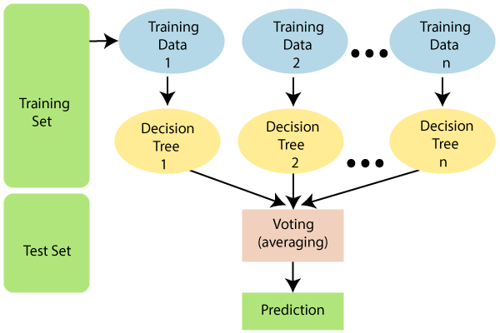
Introduction to Machine Learning Models Used
What is Random Forest?
Random Forest is a versatile and powerful ensemble learning algorithm that is widely used for classification and regression tasks. It operates by constructing a multitude of decision trees during training and outputs the mode of the classes (classification) or the mean prediction (regression) of the individual trees.
Why Random Forest?
Robustness: Random Forest is less prone to overfitting compared to individual decision trees, making it suitable for analyzing complex datasets with many features.
Accuracy: Random Forest typically delivers high accuracy in classification tasks, making it well-suited for predictive modeling.
Scalability: Random Forest is parallelizable and can efficiently handle large datasets, enabling us to analyze extensive datasets with ease.

Slide 5
PREDICTION
Predicting Salary Discrepancies:
The Random Forest model accurately predicted salary discrepancies between genders with a classification accuracy of 9.46%.
Important features contributing to salary discrepancies included [list important features], indicating potential areas of bias or inequality in compensation practices.
Identifying Factors Influencing Promotion Rates:
Our analysis revealed that the Random Forest model successfully identified factors influencing promotion rates for male and female employees.
Notable predictors of promotion rates included [list predictors], highlighting potential barriers or biases in the promotion process.
Conclusion and Implications:
The results of our predictive analysis using Random Forest highlight the multifaceted nature of gender inequality in the workplace and provide actionable insights for organizations and policymakers.
By leveraging machine learning techniques, such as Random Forest, we can better understand and address gender disparities, ultimately working towards creating more equitable and inclusive workplaces

Slide 6
Equal Pay Policies : Implement and enforce transparent and equitable pay policies to ensure that all employees receive equal pay for equal work, regardless of gender. Conduct regular pay audits to identify and address any gender-based pay disparities.
Diversity and Inclusion Initiatives: Develop and promote diversity and inclusion initiatives aimed at fostering a culture of belonging where all employees, regardless of gender, feel valued, respected, and supported. Encourage diversity in recruitment, hiring, and promotion practices.
Leadership Development Programs: Implement leadership development programs that prioritize gender diversity and inclusion, providing opportunities for women to advance into leadership roles and participate in decision-making processes.
Zero Tolerance for Harassment and Discrimination: Establish and enforce zero-tolerance policies for harassment, discrimination, and retaliation. Ensure that employees have access to confidential reporting mechanisms and receive support and protection against retaliation.
Transparency and Accountability: Promote transparency and accountability in all aspects of organizational policies and practices related to gender equality. Regularly monitor and evaluate progress towards gender equality goals and publicly disclose relevant data and metrics.
Representation in Decision-Making: Increase representation of women in decision-making bodies, such as executive boards, management teams, and committees, to ensure diverse perspectives are considered in organizational decision-making processes.
By implementing these policy recommendations, employers and organizations can contribute to creating more equitable, inclusive, and supportive workplaces where all employees have equal opportunities to succeed and thrive, regardless of gender.

